Slide 1
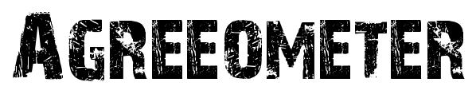
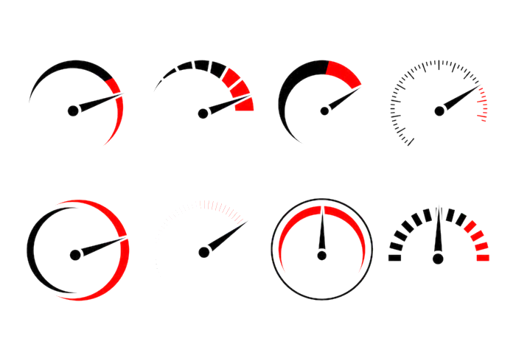
Mixed emotions
Centre ground
Assorted
Conflicted
Somewhat
Slightly
Fairly
To an extent
Increasingly
In part
Divided
To a certain extent
Partially disagree
Moderately
Not wholly
To an increasing extent
Partially agree
Considerably
Substantially
Noticeably
Markedly
Definitely
Unreservedly
Absolutely
In conflict with
Counter
Clash
Object to
Struggle to understand
Categorically
Wholeheartedly
Categorically
Candidly
Unequivocally
Applaud
Essentially
Radically
Fundamentally disagree
Fundamentally agree
AGREEOMETER Use the word bank to improve your evaluation (AO4) responses and show engagement with the ideas.

