Slide 1
GCSE English Language
PPE Review - Paper 2

Slide 2
WALT
To review your PPE Paper 2 answers
To make notes on WWW/EBI
To identify ‘Next Steps’

Slide 3
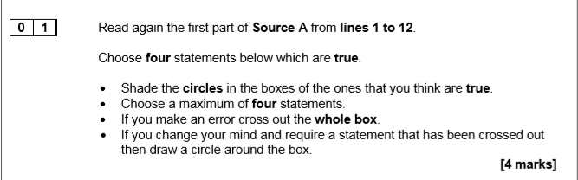
Question 1 – Keywords of the question?

Slide 4
Question 1 – Keywords of the question?
Read again Source A from lines 1 to 12.
Choose four statements below which are TRUE.
Shade the circles in the boxes of the ones that you think are true.
Choose a maximum of four statements.
If you make an error cross out the whole box.
If you change your mind and require a statement that has been crossed out then draw a circle around the box. [4 marks]
This was an issue. People did not follow the instructions. This could stop you receiving the marks.

Slide 5
Question 1 – General Feedback?
Some of you managed 4 marks out of 4, which we would expect!
However, there was a significant number of you only getting 2 or 3.
Complete the review sheet for this question.
What are your WWWs/EBIs?

Slide 6
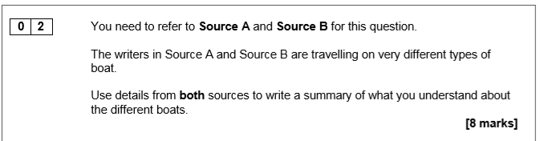
Question 2 – Keywords of the question?

Slide 7
Question 2 – Keywords of the question?
Don’t ignore the focus of the summary.
Most of you did use both texts
Not enough focus on the boats

Slide 8
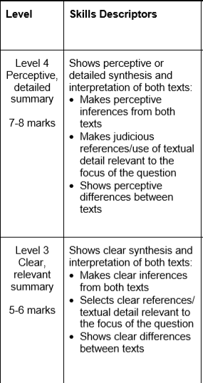
Question 2 – General Feedback?
Critical that you read the question and make sure you are focusing on the right parts of the text.
Be clear on what a summary actually means.
Give 3-4 ideas from each text, with short quotations to support.
Complete the review sheet for this question.
What are your WWWs/
EBIs?
Notes:
Teacher to personalise this slide using whole class feedback sheets

Slide 9
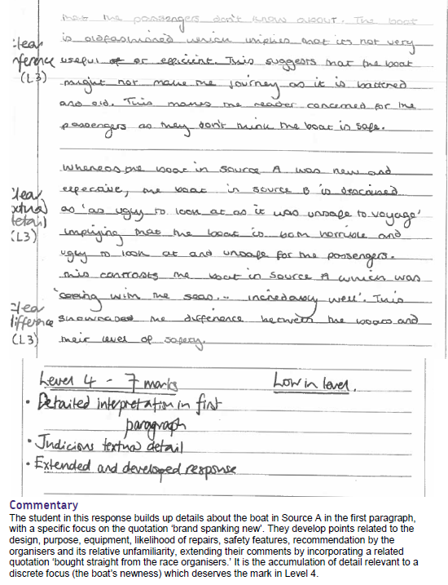
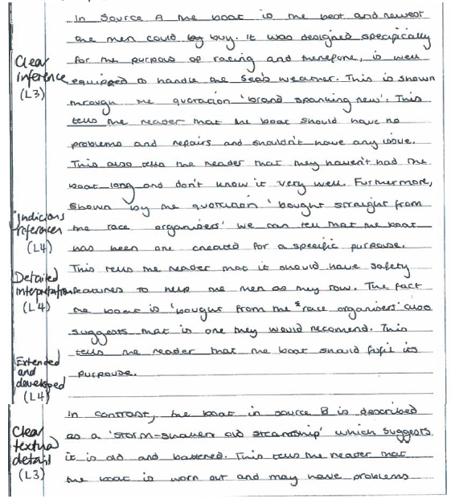

Slide 10
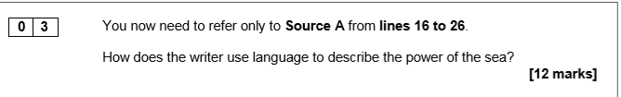
Question 3 – Keywords of the question?

Slide 11
Question 3 – Keywords of the question?
Most of you did mention ONLY Source A and most included quotations.
Not enough of you used technical terms or mentioned the effect on the reader.

Slide 12
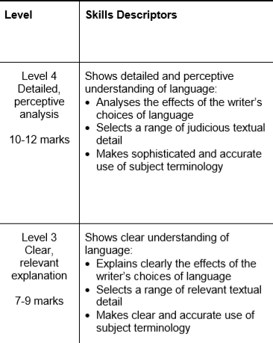
Mark scheme
Make note of the key words the examiner is looking for.
Detailed and perceptive = confident grasp of the way language has been used, notices the develops and shifts/changes, nuanced interpretation.
Clear and relevant= explicit link between method and effect, clear understanding of the effects and meanings.

Slide 13
Question 3 – General Feedback?
Length of answer?
Need to explicitly link methods used and the effects achieved. HOW and WHY.
Not enough of you mentioned why the writer used the language techniques and the effect on the reader.
Most of you did included quotations BUT…
  Some of the quotations were far too long. This takes a long time to copy out and just not specific enough.
  Your comments were FAR TOO general e.g. “…creates an image in the mind of the reader”. What type of image? Frightening? Monstrous?
Complete the review sheet for this question.
What are your WWWs/
EBIs?
Notes:
Teacher to personalise this slide using whole class feedback sheets

Slide 14
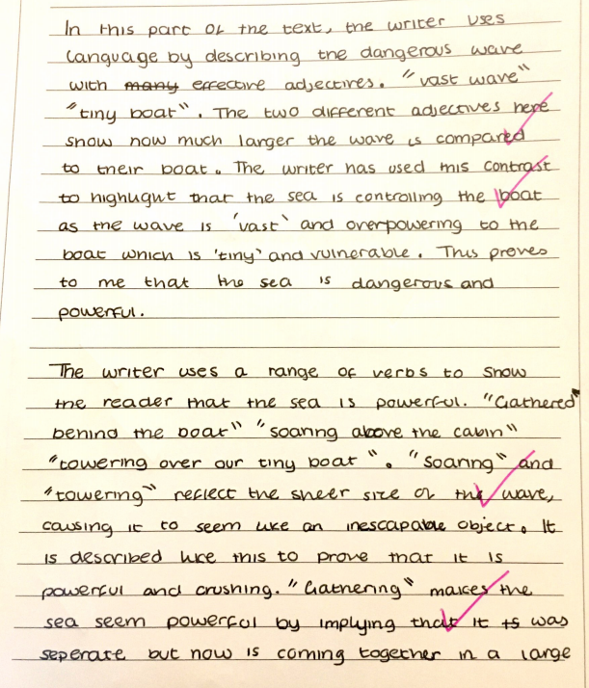
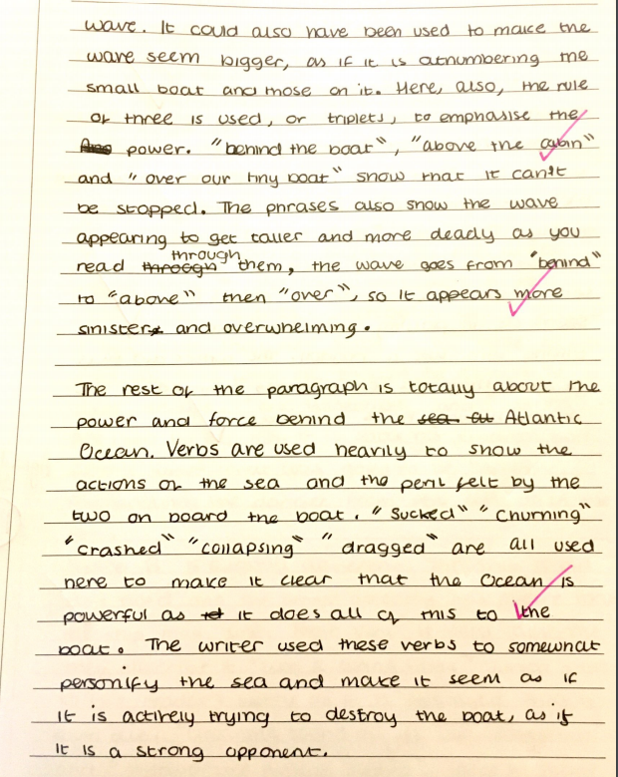

Slide 15
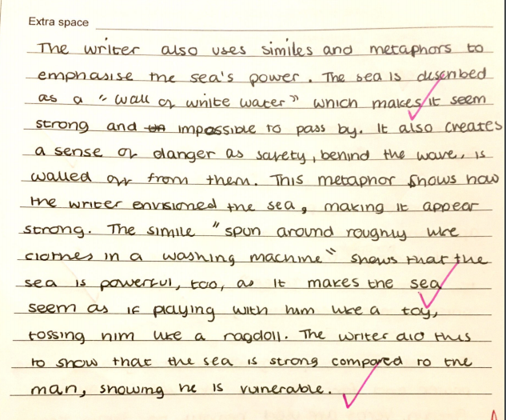
Examiner comment:
This answers achieves 11 marks, and therefore is low in level 4. It uses a judicious range of evidence. It also analyses in detail the methods selected and is beginning to have a confident interpretation of the effects.

Slide 16
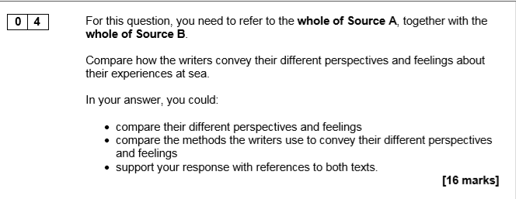
Question 4 – Keywords of the question?

Slide 17
Question 4 – Keywords of the question?
Most of you did cover both texts
Too many of you seemed to ignore the COMPARISON and HOW part of the question
Focus of the comparison. It is NOT comparing everything.
They give you these bullet points to help you – USE THEM!
Root your answer in the methods. If you start each WHW with the method you will be focusing on it and HOW should follow.

Slide 18
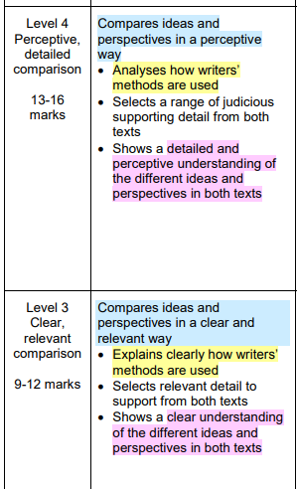
Mark Scheme
To improve understand the key words and what they mean for this question:
Perceptive and detailed comparison= conceptualised, insightful, developed, fine distinctions are considered, analytical detail on developments and shifts, mature, subtle, confident
Clear and relevant= focused on task, explained, connects like with like, interpretation of similarities/differences, explicit link between method and effect.

Slide 19
Question 4 – General Feedback?
Length of answer – most of you were far too brief – 1 side is not enough by far for 16 marks! TIMING?
Not enough comparison words – however, whereas, similarly –that show you are actually answering the question.
Most comments were too vague and lacked specifics – just like the previous question.
Lead your response with the method and then compare HOW the writer’s use the methods to show the perspectives and feelings.
Complete the review sheet for this question.
What are your WWWs/
EBIs?
Notes:
Teacher to personalise this slide using whole class feedback sheets

Slide 20
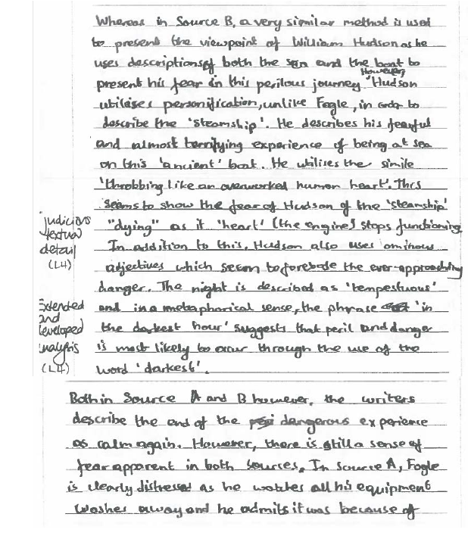
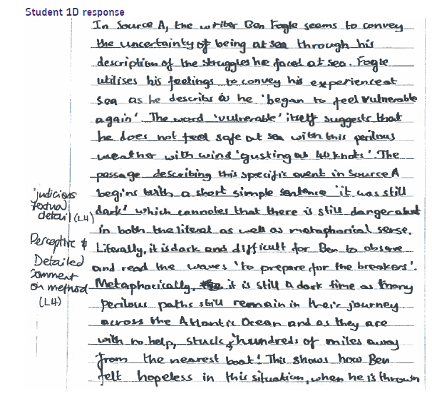

Slide 21
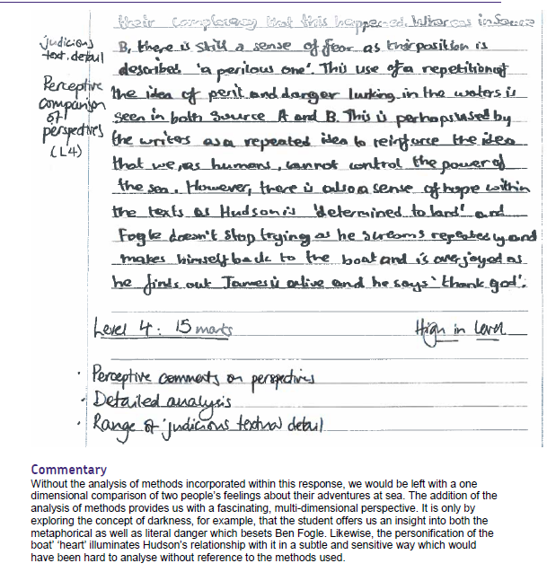

Slide 22
Question 5 – Keywords of the question?
The ADVICE
You are advised to spend about 45 minutes on this section.
You are reminded of the need to plan your answer.
You should write in full sentences.
You should leave enough time to check your work at the end.

Slide 23
Question 5 – Keywords of the question?
The ADVICE
Did you actually spend this amount of time? Too many very short answers.
You are advised to spend about 45 minutes on this section.
You are reminded of the need to plan your answer.
You should write in full sentences.
You should leave enough time to check your work at the end.
Not enough plans seen
Sentence variety was generally very limited.
Too many basic errors to think that you actually did this!

Slide 24
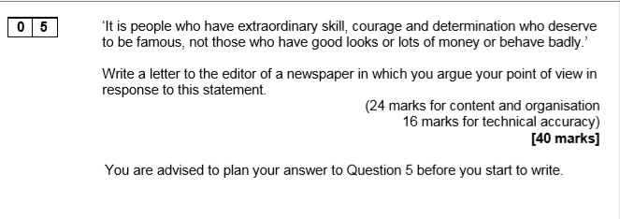
Question 5 – Keywords of the question?

Slide 25
Question 5 – Keywords of the question?
Statement to respond to- needed to be broken down
Too many of you did NOT know how to set out a formal letter, let alone an actual address
Sentence control and punctuation. Spelling accuracy. PARAGRAPHS!
The newspaper is not responsible. You can’t have a rant at them. If I read one more thing about footballers or Kim Kardashian I will scream!
Very few plans seen

Slide 26
Question 5 – General Feedback?
Length of answer – most of you were far too brief. This should have taken you (with planning and checking – about 30 minutes to write). 3+ sides is what was necessary.
Variety of ideas- there are more famous people in the world than footballers and Kim Kardashian!?
Anecdotes must be used to support ideas.
Build your argument and amplify your ideas in how your structure them.
Use a wider variety of sentence lengths, starters, punctuation and ambitious vocabulary.
Complete the review sheet for this question.
What are your WWWs/
EBIs?
Notes:
Teacher to personalise this slide using whole class feedback sheets

Slide 27
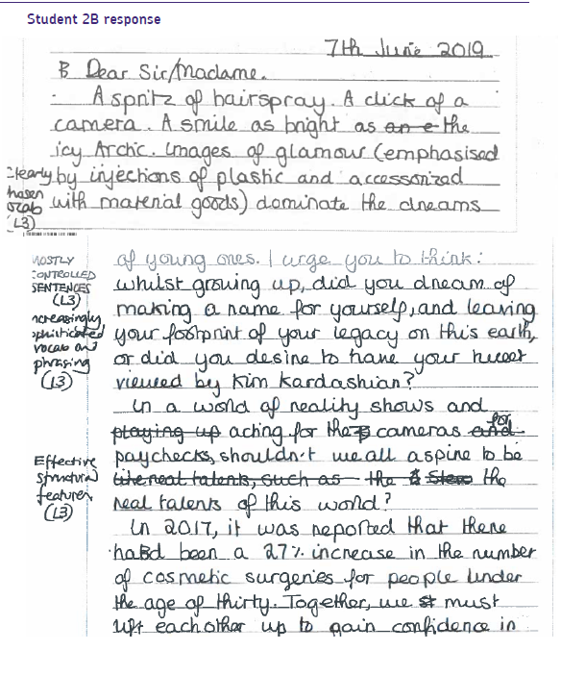
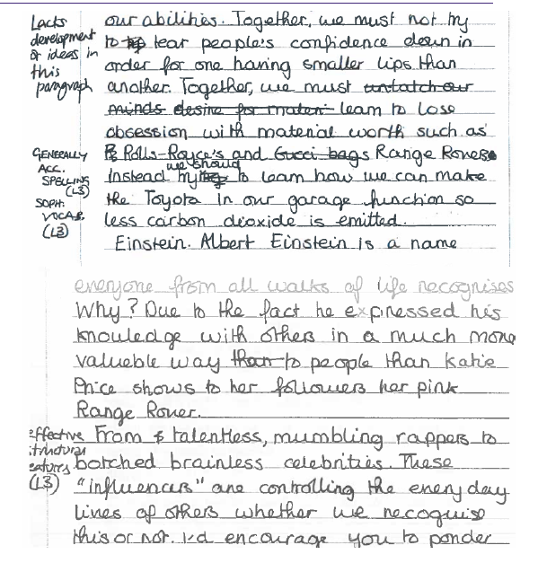

Slide 28
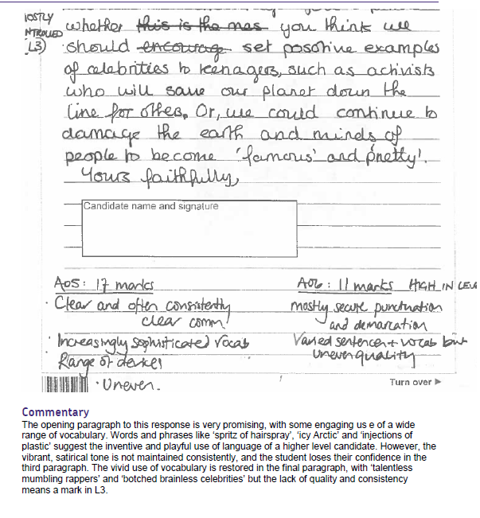

Slide 29
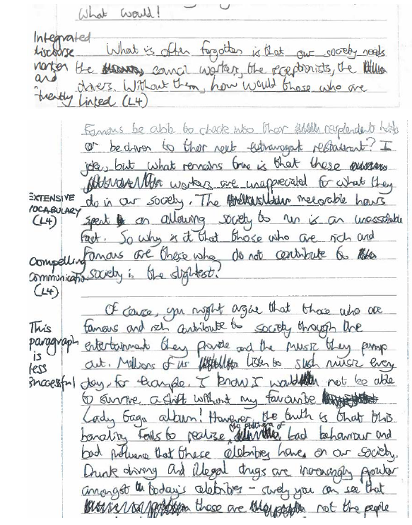
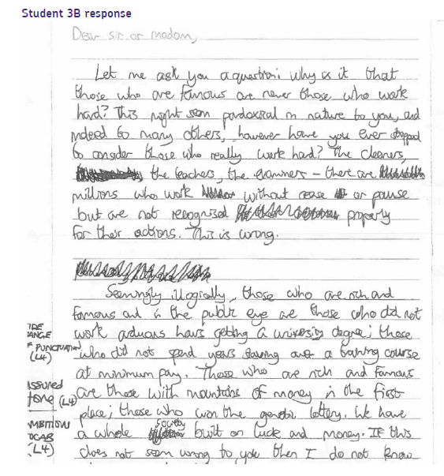

Slide 30
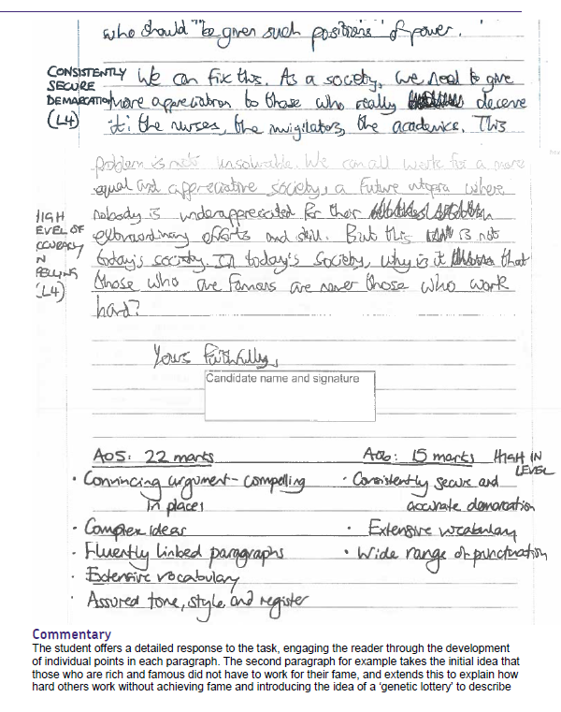

Slide 31


Next Steps
Look at your EBIs and complete the review sheet. What do you need to do in the real exam?
Correct your errors in Question 5!

