Slide 1
PPE 1st feedback lesson

Slide 2
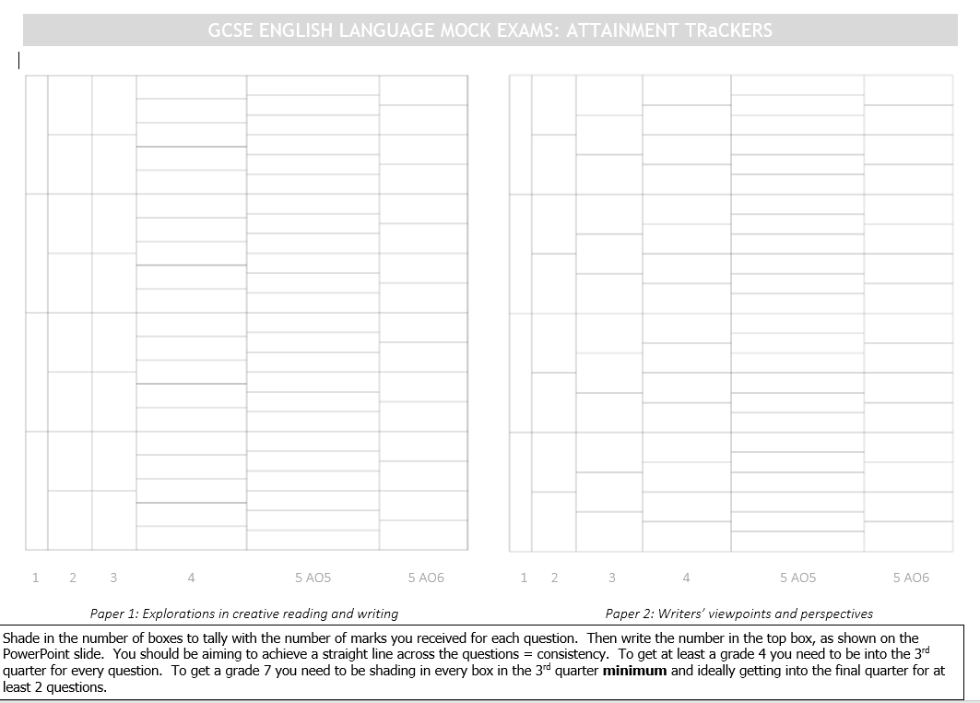
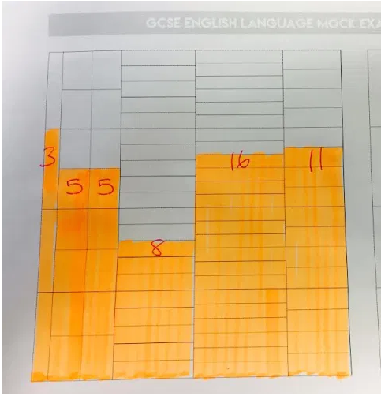
Notes:
Explain how this needs to be completed. Explain how the boxes are proportional to what they are worth in the exam. Give out exam papers and students to complete the trackers sheets. Use the time to answer any questions that come up.

Slide 3
Papers 1 and 2
Paper 1
Paper 2
Mark | Grade
8 | 1
19 | 2
30 | 3
41 | 4
46 | 5
51 | 6
58 | 7
63 | 8
68 | 9
Mark | Grade
9 | 1
19 | 2
29 | 3
39 | 4
44 | 5
50 | 6
56 | 7
61 | 8
66 | 9

Slide 4
Overall grade boundaries
Mark | Grade
17 | 1
38 | 2
59 | 3
80 | 4
90 | 5
102 | 6
113 | 7
124 | 8
134 | 9

Slide 5
Whole class picture
Teacher to personalize using whole class feedback sheet. Suggest a star performers section and overall what needs to be worked on.

Slide 6
Targets- Reading
Explain how and why fully and in detail.
Embed short quotations into your response to support your arguments
Link back to the statement/question throughout your answer.
Make sure you cover the start, middle and end of the extract.
Give a wider range of ideas aim for 5 fantastic points (question 4 paper 1 only)
Make sure you give a wider range of different ideas from both texts (Paper 2 only)
Use subject terminology to support your arguments
Don’t just technique spot- analyse HOW the method has been used.
Lead your response with the method and how the method is used.
Critically evaluate the effects by drawing the ideas together from across the text (paper 1 questions 4)
Make clear inferences from both texts (paper 2 question 2 only)
Clear explain the effects of language/structure choices by the writer.
Give a detailed understanding of the different ideas and perspectives in both texts (Paper 2 question 4 only)
Use your time more carefully to make sure you give full responses to all questions.
Notes:
Teacher to add in any addition targets as used by themselves or their partner marker

Slide 7
Targets- writing
Make sure you read the question carefully and write for the correct genre, audience and purpose.
Engage the reader through your use of language techniques.
Use paragraphs to clearly organise and develop your ideas.
Must get the basic punctuation correct of full stops, capital letters and commas.
Very your sentence starters
Vary your sentence lengths to add meaning to your writing.
Develop characterisation (paper 1 only)
Develop your description- show me, don’t tell me (paper1 only)
Use a range of rhetorical devices to craft your argument (paper 2 only)
Use paragraph length and structure to add meaning to your writing.
Link ideas and sentences across your writing using a thread/connectives/adverbs
Write in a compelling and convincing way to engage the reader throughout (Level 4)
Make conscious vocabulary choices to add effect and meaning to your writing.
Plan your answer before you start to make your ideas more organised.
Notes:
Teacher to add in any addition targets they used or ones used by partner marker.

Slide 8
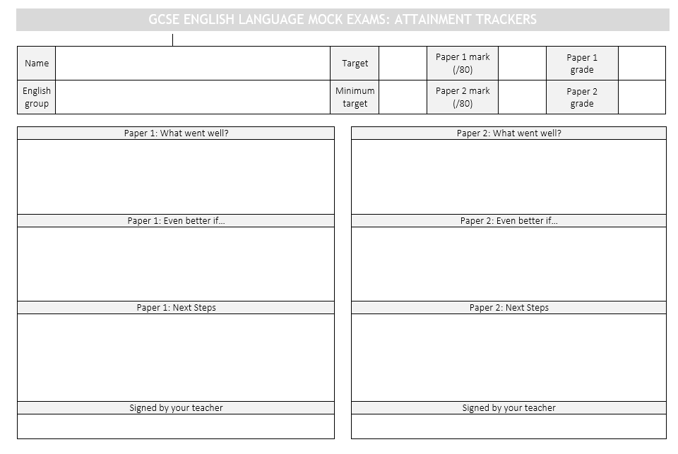
Notes:
Explain sheets which will be completed this lesson. Today will be a general overview and identifying main areas of improvement. Students begin to complete

Slide 9

Notes:
Chance for them to tell the teacher how they are feeling about result/what feel they would like from us/what they need to do. Teacher to personalize.

