Slide 1


How to revise English presentation
Mrs Natalie Whitehill

Slide 2
AQA GCSE English Language (8700)
Paper 1:
Explorations in creative reading and writing
2 sections each worth 40 marks. Total marks: 80
Exam: 1 hour, 45 mins
50%
Paper 2:
Writer’s Viewpoints and perspectives
2 sections each worth 40 marks. Total marks: 80
Exam: 1 hour, 45 mins
50%
Component 3: Spoken Language
Non-exam assessment
Unweighted
To be completed in year 9 or year 10.
Section A: Extract (25%)
Reading (1 hour) Total marks: 40
4 questions.
Assessment Objectives covered: AO1, AO2 and AO4
One prose extract of C20th or C21st literature.
Section A: Non-fiction reading (25%)
Reading (1 hour) Total marks: 40
4 questions (A question on each text individually and 2 questions which use both texts)
Assessment Objectives covered: AO1, AO2 and AO3
Two non-fiction extracts from C19th & C21st or C20th.
3. Spoken Language
One presentation/speech, including responses to questions and feedback.
Section B: Question 5 Descriptive or narrative Writing (25%)
Writing (45 mins) Total marks: 40
A descriptive or a narrative piece. One question has a picture as a stimulus.
Section B: Question 5 Writing to present a viewpoint (25%)
Writing (45 mins) Total marks: 40
One task which must be completed and showcases the candidates ability to write to present a viewpoint e.g. letter, article etc.
100% examination in the summer of Year 11
Graded 9-1 (9 being highest)

Slide 3
AQA GCSE English Literature (8702)
Paper 1:
Shakespeare and the C19th Novel
2 sections each worth 30 marks with 4 marks available for AO4 in Section A
Exam: 1 hour, 45 mins
40%
Paper 2:
Modern texts and poetry
Sections A and B are worth 30 marks each.
Section C is worth 32 marks across 2 questions.
4 marks are available for AO4 in Section A.
Exam: 2 hours, 15 mins
60%
100% examination in Year 11
Graded 9-1 (9 being highest)
Section A Post-1914 Drama (20%)
An Inspector Calls
(45 mins) Total marks = 30 + 4 for AO4
A choice of 2 questions. Students must complete just 1.
Section A: Shakespeare (20%)
Romeo and Juliet
(55 mins) Total marks = 30 +4 for AO4
An extract from the play is provided for students to write about in detail. Then they also need to write about the play as a whole.
AO1 and AO2 are assessed in all 30 and 24 mark questions on the paper.
AO3 is assessed in sections A and B of both papers.
Paper 2, question 27.2 assesses AO2 only.
Section B (20%)
Love and Relationships poetry anthology
(45 mins) Total marks= 30
1 question with one named poem from the 15 studying during the course to be printed. Students must compare the printed poem and another poem, of their choice, from the 15.
Section B: C19th Novel (20%)
The Sign of Four
(50 mins) Total marks = 30
An extract from the novel is provided for students to write about in detail. Then they also need to write about the novel as a whole.
Section C Unseen Poetry (20%)
(45 mins split into 30 mins and 15 mins) Total marks= 32
Question 27.1- 1 unseen poem response linked to a given focus- 24 marks
Question 27.2 The first unseen poem and a second unseen poem to be compared for AO2 only- 8 marks.

Slide 4


To revise or not to revise, that is the question.

Slide 5
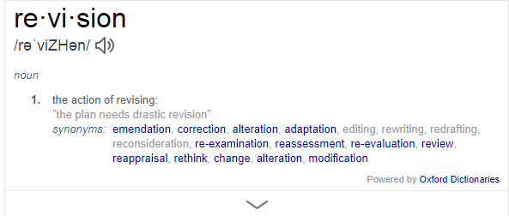
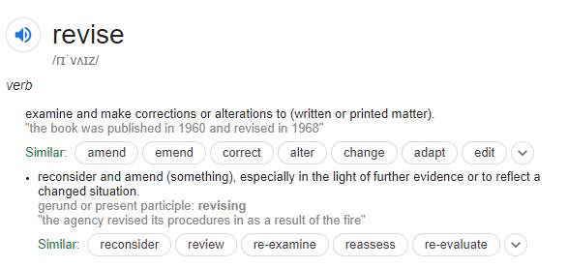
What is it?

Slide 6
The key is to be realistic. Yes, they will have less free time temporarily. No, they will not, and should not, have to go without free time completely. Yes, there is time to make that difference now.
Notes:
The science bit

Slide 7

Power of reading
Reading for pleasure is more important for children's cognitive development than their parents' level of education and is a more powerful factor in life achievement than socio-economic background. ⁶
Having books in the home is associated with both reading enjoyment and confidence.
Notes:
https://readingagency.org.uk/about/impact/002-reading-facts-1/#fn616-year-olds who choose to read books for pleasure outside of school are more likely to secure managerial or professional jobs in later life. ⁷
Of children who report having fewer than 10 books in their homes, 42% say they do not like reading and only 32% say they are 'very confident' readers. For children who report having over 200 books at home, only 12% say they do not like reading and 73% consider themselves 'very confident' readers. ⁸

Slide 8
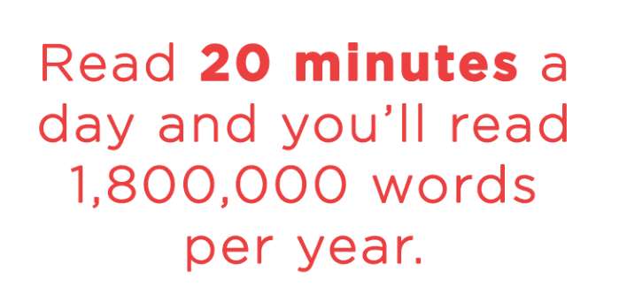
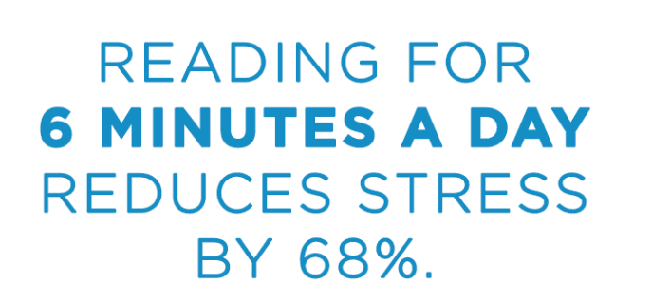

Slide 9
Reading questions you could use
How does the writer make you feel?
How has the writer achieved that impact?
What are the top three techniques the writer has used? Why?
How is the text organised to make the ideas more effective?
How does the writer grab your attention at the start?
How does the writer end the text? Why end it in this way?
Has the writer used any other features to make the writing more successful/interesting? What are they and how are they used?
What are your predictions about the text?

Slide 10

Quality above quantity
It is important to focus on the quality rather than just the quantity of your revision. This means that, whatever time you do spend revising, you try to make sure that it:
is quality time;
with full concentration; and
with the most appropriate revision method.

Slide 11


Slide 12
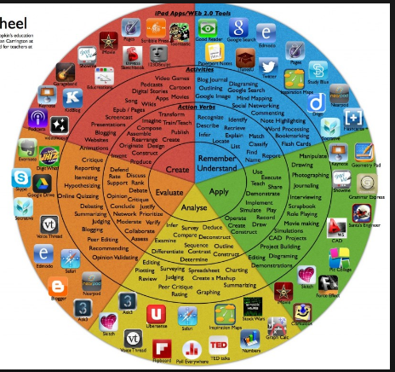

Slide 13



Slide 14
AQA GCSE English Literature (8702)
Paper 1:
Shakespeare and the C19th Novel
2 sections each worth 30 marks with 4 marks available for AO4 in Section A
Exam: 1 hour, 45 mins
40%
Paper 2:
Modern texts and poetry
Sections A and B are worth 30 marks each.
Section C is worth 32 marks across 2 questions.
4 marks are available for AO4 in Section A.
Exam: 2 hours, 15 mins
60%
100% examination in Year 11
Graded 9-1 (9 being highest)
Section A Post-1914 Drama (20%)
An Inspector Calls
(45 mins) Total marks = 30 + 4 for AO4
A choice of 2 questions. Students must complete just 1.
Section A: Shakespeare (20%)
Romeo and Juliet
(55 mins) Total marks = 30 +4 for AO4
An extract from the play is provided for students to write about in detail. Then they also need to write about the play as a whole.
AO1 and AO2 are assessed in all 30 and 24 mark questions on the paper.
AO3 is assessed in sections A and B of both papers.
Paper 2, question 27.2 assesses AO2 only.
Section B (20%)
Love and Relationships poetry anthology
(45 mins) Total marks= 30
1 question with one named poem from the 15 studying during the course to be printed. Students must compare the printed poem and another poem, of their choice, from the 15.
Section B: C19th Novel (20%)
The Sign of Four
(50 mins) Total marks = 30
An extract from the novel is provided for students to write about in detail. Then they also need to write about the novel as a whole.
Section C Unseen Poetry (20%)
(45 mins split into 30 mins and 15 mins) Total marks= 32
Question 27.1- 1 unseen poem response linked to a given focus- 24 marks
Question 27.2 The first unseen poem and a second unseen poem to be compared for AO2 only- 8 marks.

Slide 15
Literature texts- Must
Plot and order events happen in- why do they happen in this order?
Characters- who they are, spelling names correctly, importance to the plot, relationships with others, personality traits.
Settings- how the writer uses them, where set, some quotations on them.

Slide 16
Literature texts- Should
Plot and order events happen in- why do they happen in this order? What does the writer achieve by doing it in this order? Key quotations.
Characters- How the writer allows the character to be revealed, grow, develop, react and change and why. Quotations related to the key characters.
Settings- Why have these settings been chosen? How are they used to develop plot? Mirror events? Intensify characters?

Slide 17
Active ways to revise Literature texts
Self-quizzing
Knowledge organisers
Making cue cards which marry words, images and colours.
Turning chapters/poems/acts into images supported with a quotation
Creating question and answer cards
Re-reading set texts
Watching film versions of AIC & R&J and then making notes.
Create summary sheets. Start off with 100 words, then go down-50, 30, 10, 5.
Reading exemplar answers and annotating them and rank ordering them for success.

Slide 18
Other approaches to consider
Re reading notes from class
Turning notes into another format e.g. poems, newspaper articles.
Sticking post-it notes around your house/room
Testing yourself by creating quizzes
Mnemonics
A4 placemats
Five fantastic points
Use different colour pens
Use mind maps on A3 paper
On line e.g. Kahoot, pinterest
BBC Bitesize
Study guides
You tube videos- watching them and making one?
School revision sessions- Masterclasses Tuesday lunchtime
Flashcards
Make a podcast/CDs

Slide 19


Slide 20
AQA GCSE English Language (8700)
Paper 1:
Explorations in creative reading and writing
2 sections each worth 40 marks. Total marks: 80
Exam: 1 hour, 45 mins
50%
Paper 2:
Writer’s Viewpoints and perspectives
2 sections each worth 40 marks. Total marks: 80
Exam: 1 hour, 45 mins
50%
Component 3: Spoken Language
Non-exam assessment
Unweighted
To be completed in year 9 or year 10.
Section A: Extract (25%)
Reading (1 hour) Total marks: 40
4 questions.
Assessment Objectives covered: AO1, AO2 and AO4
One prose extract of C20th or C21st literature.
Section A: Non-fiction reading (25%)
Reading (1 hour) Total marks: 40
4 questions (A question on each text individually and 2 questions which use both texts)
Assessment Objectives covered: AO1, AO2 and AO3
Two non-fiction extracts from C19th & C21st or C20th.
3. Spoken Language
One presentation/speech, including responses to questions and feedback.
Section B: Question 5 Descriptive or narrative Writing (25%)
Writing (45 mins) Total marks: 40
A descriptive or a narrative piece. One question has a picture as a stimulus.
Section B: Question 5 Writing to present a viewpoint (25%)
Writing (45 mins) Total marks: 40
One task which must be completed and showcases the candidates ability to write to present a viewpoint e.g. letter, article etc.
100% examination in the summer of Year 11
Graded 9-1 (9 being highest)

Slide 21



What works for language? Reading
Reading a range of fiction and non-fiction. Then summarise it, drawing out the key points.
GAP/FLAP the texts.
Designing your own questions in the style of the exams.
Writing their own indicative content for answers to reading questions.
Writing responses and practising what, how, why.
Peer assessing each other and improving on answers.
Revising subject terminology

Slide 22
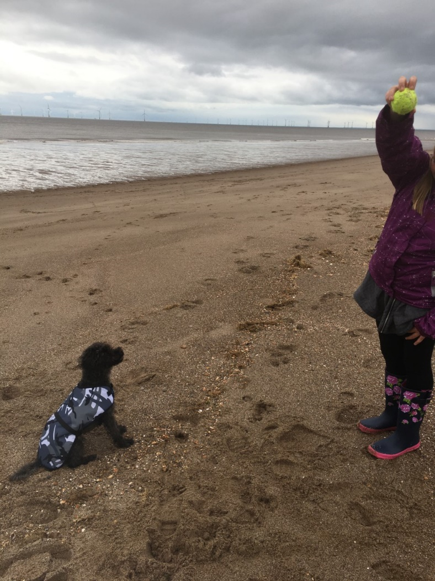
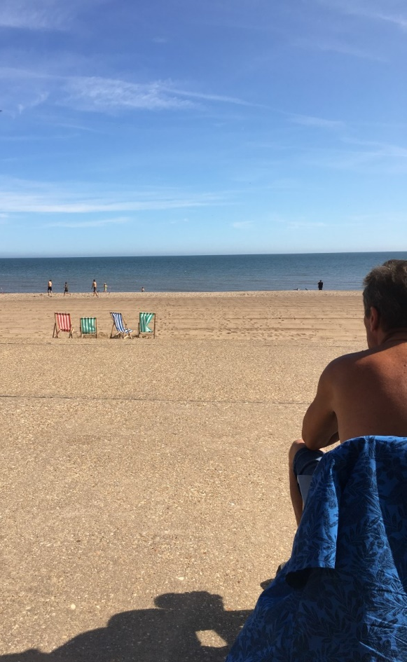
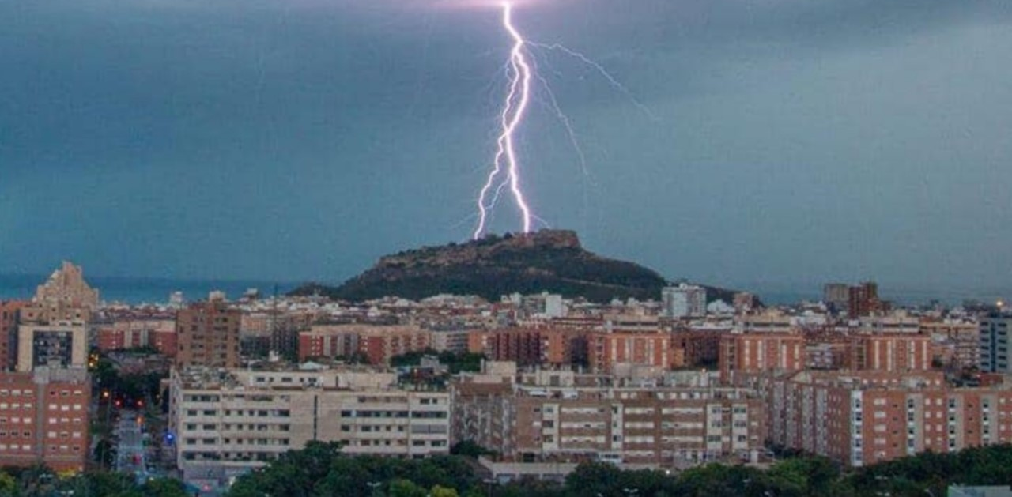
What works for Language? Paper 1 Writing
Planning written responses to a range of pictures.
Planning narratives using the same characters, the same, settings and same plot but to different tasks.
Working on core spellings
Developing imagery and show me, don’t tell me.
Reading fiction and noting techniques used by writer they can try and emulate.
Notes:
Title possibilities: A wish. The decision, A dangerous experience, the challenge, the storm,

Slide 23

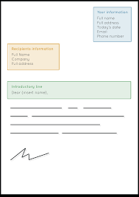
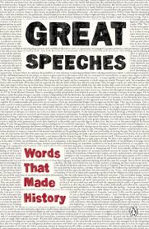

What works for Language? Paper 2 Writing
Planning for the 5 text types they could be asked to write: formal letter, article, speech, leaflet and essay.
Deciding questions for GAP/FLAP
Revising the key conventions of each text type and knowing HOW to use each one.
Writing using a range of persuasive devices including repetition, rhetorical questions
Core spellings and common mistakes
Developing an argument in a clear and structured way.
Reading non-fiction and noting techniques used by writer you can try and emulate.
Notes:
Title topics- climate change, improving facilities for young people,

Slide 24
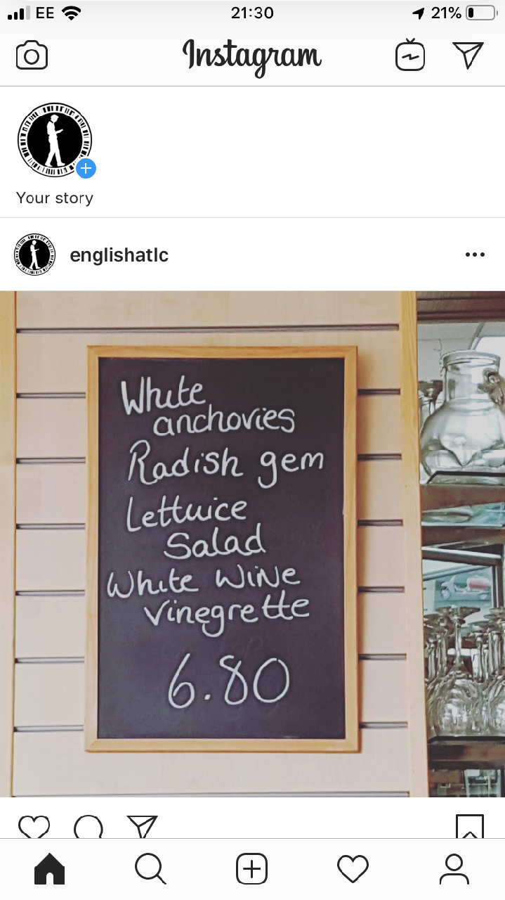
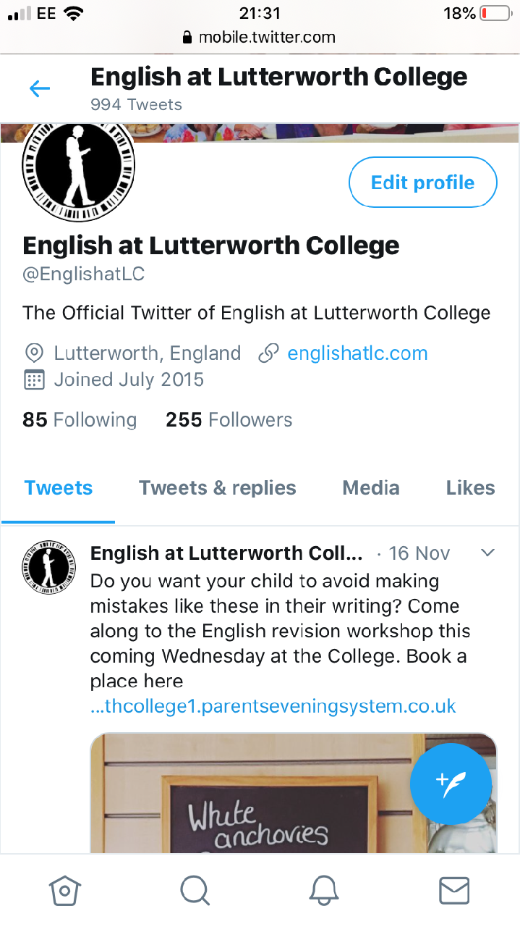
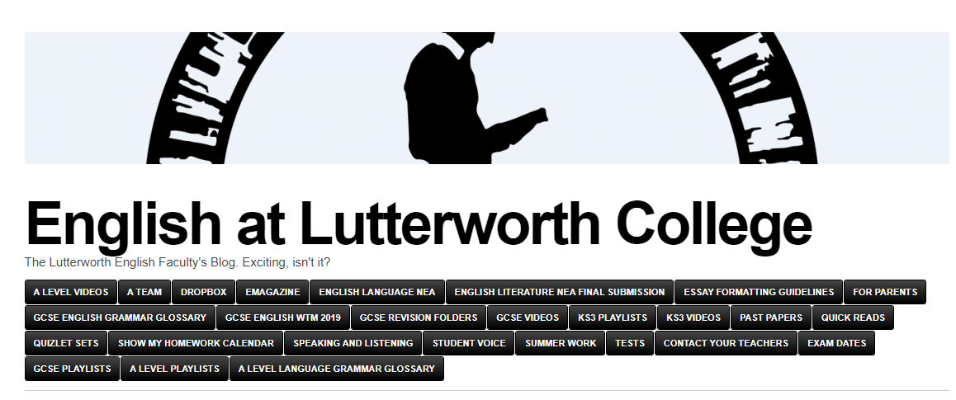
On line

Slide 25
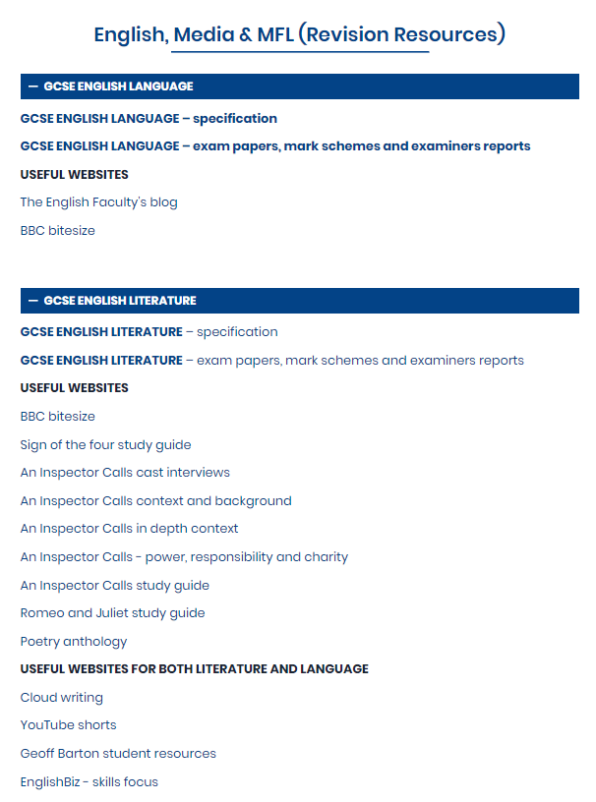
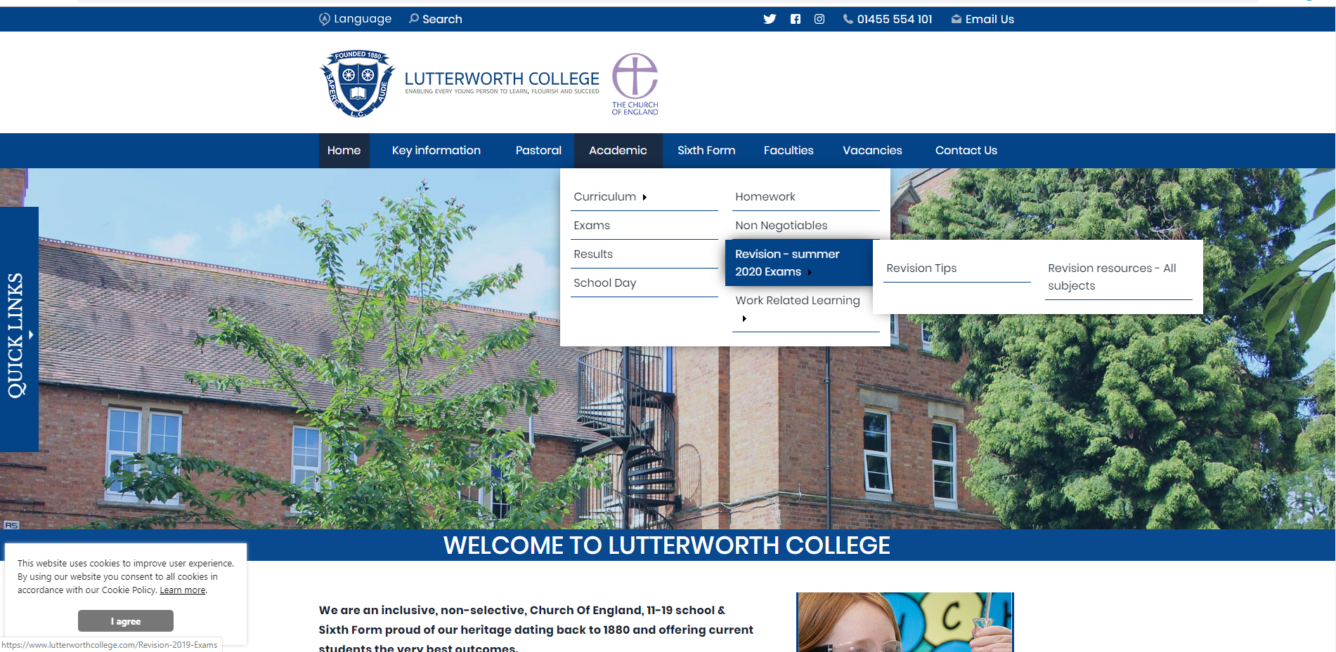
On line

Slide 26
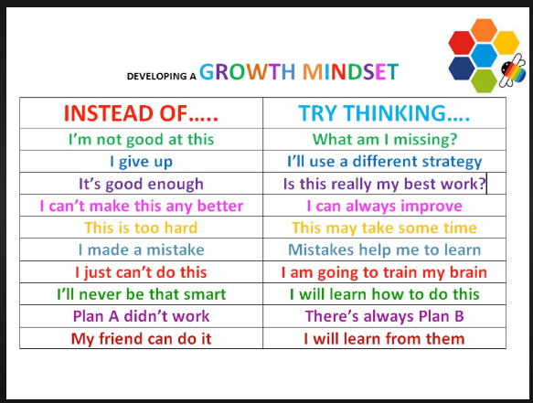

Slide 27
